Slide 1


Course Navigation Tips
Use the buttons at the bottom of the course slides to adjust your viewing settings.
It is recommended that you read the slides in
There is no audio for this course.
Advance to the next slide when you finish reviewing this diagram.
full screen view.
Adjusts or mutes audio.
Full screen view
Go to previous slide
Go to next slide
Toggle button: pause or
play
Slide number/total slides
Slide play time

Slide 2

Welcome to Rapid Regulatory Compliance: Non-clinical Part I
This course will rapidly review
and update your knowledge of:
Compliance and ethics
Patient rights
Patient care and protection
Quality Improvement
If you have concerns about any aspect of the safety or quality of patient care
in your organization, be aware that you may report these concerns directly to
Your subsidiary Compliance Officer
The Corporate Compliance Hotline at 1-866-MHC-COMPly
Your accrediting body (The Joint Commission)

Slide 3
Course Objectives
After completing this review, you should be able to:
Cite key points of relevant laws and regulations for healthcare.
Define sexual harassment.
Cite key points related to patient rights.
Review the quality improvement model used throughout McLaren Health Care.

Slide 4
Course Outline
Lesson 1 will focus on corporate compliance and ethical issues in healthcare. This includes laws and regulations, consequences of noncompliance, and features of a compliance program. Sexual harassment and McLaren as a Federal Contractor will also be discussed.
Lesson 2 will discuss patient rights, which include confidentiality, patient participation in treatment decisions, respect, safety and nondiscrimination, and patient visitation rights. Grievances will also be discussed. Patient confidentiality is discussed in the MHC HIPAA self-learning module.
Lesson 3 will focus on quality improvement.
Lesson 1: Corporate Compliance and Ethics
  Compliance laws and regulations
  Potential consequences of non-compliance
  Compliance programs
  Sexual Harassment
  Federal Contractors
Lesson 2: Patient Rights
  Confidentiality
  Patient participation in treatment decisions
  Disclosure and Informed Consent
  Advance Directives
  Access to Emergency Services
  Respect, safety, and nondiscrimination
  Patient visitation rights
  Grievances
  Lesson 3: Quality Improvement
  Why it is important and what it is
  Our expectations
  The PDSA Cycle

Slide 5

Lesson 1: Compliance and Ethics
This lesson addresses:
  Corporate Compliance
  Sexual Harassment

Slide 6

Corporate Compliance:
Introduction
In recent years, government agencies have started to look more closely for healthcare fraud and misconduct.
A lot of federal money has been used to investigate and prosecute suspected fraud.
This has increased the number of providers convicted of fraud.

Slide 7
Corporate Compliance:
Laws and Regulations
Corporate compliance means following business laws and regulations.
Applicable Laws and Regulations for healthcare include:
  Medicare Regulations
  Federal False Claims Act
  Stark Act
  Anti-Kickback Statute
  Sections of the Social Security Act
  Affordable Care Act
  Mail and Wire Fraud Statutes
  EMTALA
  HIPAA
  "Red Flags" Rule (Identity Theft Regulations)
HIPAA and Red Flags Rule are covered in a separate McLaren Health Care e-Learning course.
Let's take a closer look at the remaining laws and regulations.
Notes:
So let’s begin our discussion about Corporate compliance

Slide 8

Corporate Compliance:
Laws and Regulations
Let’s first look at:
Medicare Regulations
Federal False Claims Act
Stark Act

Slide 9
Medicare Regulations
Any facility that participates in Medicare must follow Medicare Regulations. For example, facilities must:
    Meet standards for quality of care
    Not bill Medicare for unnecessary care
    Not bill Medicare for costs that are higher than the usual cost
    Follow other rules for claims and billing

Slide 10
Federal False Claims Act
The False Claims Act makes it illegal to submit a falsified bill to a government agency. This act:
  Applies to healthcare because Medicare is a government agency.
  Allows a citizen who has evidence of fraud to sue on behalf of the government. This “whistleblower” is protected from retaliation for reporting the fraud.
  Note: State laws also focus on False claims in addition to the Federal False Claims Act.

Slide 11
Stark Act
The Ethics in Patient Referrals Act (EPRA) is also called the Stark Act. This Act makes it illegal for physicians to refer patients to facilities or providers:
If the physician has a financial relationship with the facility or provider
If the physician’s immediate family has a financial relationship with the facility or provider
Note: This law does not apply in certain cases.

Slide 12
Corporate Compliance:
Laws and Regulations
Let's next look at:
Anti-Kickback Statute
Sections of the Social Security Act
Mail and Wire Fraud Statutes
Affordable Care Act

Slide 13
Anti-Kickback Statute
The Medicare and Medicaid Patient Protection Act of 1987 is also called the Anti-Kickback Statute (AKBS). This act makes it illegal to give or take kickbacks, bribes, or rebates for healthcare that will be paid for by a government program.
Note: This law does not apply in certain cases.

Slide 14
Sections of the Social Security Act
The Social Security Act makes it illegal for hospitals to:
Pay physicians to encourage them to limit services to Medicare or Medicaid patients.
Offer gifts to Medicare or Medicaid patients to get their business.

Slide 15
Mail and Wire Fraud Statutes
Mail and wire fraud statutes make it illegal to use the U. S. Mail or electronic communication as part of a fraud. For example, these statutes make it illegal to mail a fraudulent bill to Medicare.

Slide 16
Corporate Compliance:
Laws and Regulations
Finally, let's look at:
EMTALA
Note: HIPAA and the Red Flags Rule (medical identity theft) are covered in a separate McLaren Health Care specific self-learning module.

Slide 17
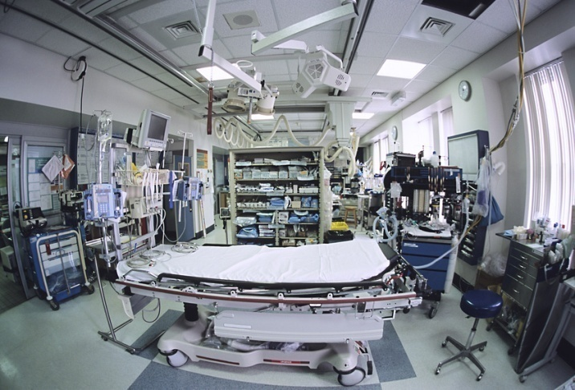
EMTALA
The Emergency Medical Treatment and Active Labor Act (EMTALA) is also called the Patient Anti-Dumping Statute. This statute requires Medicare hospitals to provide emergency services to all patients, whether or not the patient can pay.
Hospitals are required to:
Screen all patients who come to the emergency room and determine whether or not they have an emergency condition.
Stabilize patients who do have an emergency condition

Slide 18

Corporate Compliance: Potential Consequences of Noncompliance
When a provider is convicted of breaking any of the laws for healthcare, penalties can include:
  Criminal fines
  Civil damages
  Jail time
  Exclusion from Medicare or other government programs
  In addition, a conviction can lead to serious public relations harm.

Slide 19

Corporate Compliance:
Compliance Programs
To help prevent misconduct, healthcare facilities have corporate compliance programs.
  A good compliance program reduces the risk of fraud.
  It does so by giving guidelines for how to do your job in an ethical and legal way.
  A copy of your facility's compliance program should be readily available to you. Ask your supervisor or compliance officer for more information.

Slide 20
Sexual Harassment
Title VII of the Civil Rights Act of 1964 defines sexual harassment.
This definition is summarized in the graphic to the right.
To work toward eliminating sexual harassment in your facility:
  Be aware of the definition of sexual harassment.
  If you are a victim, confront the harasser directly, if you feel able to do so.
  Follow your facility's policies and procedures for reporting harassment.
Summary of Title VII Definition
of Sexual Harassment
  Sexual harassment involves the following actions:
  Sexual advances,
  Requests for sexual favors, or
  Other conduct/communication of a sexual nature.
  When these actions are unwelcome and:
  Affect job status
  Interfere with work performance, or
  Create a hostile work environment

Slide 21
Federal Laws Requiring Affirmative Action by Federal Contractors
Hospitals are Federal Contractors if they:
Have contracts with the federal government to provide health care to federal employees
Provide health care services to active or retired military personnel under TRICARE
Some McLaren subsidiaries are Federal Contractors, therefore, the entire MHC system is considered a Federal Contractor.
Federal contractors must adhere to Federal laws requiring affirmative action:
  Executive Order 11246 – prohibits discrimination against applicants and employees based on race, color, religion, sex, sexual orientation, gender identity, national origin
  The Rehabilitation Act – prohibits discrimination based on mental and physical disabilities
  Vietnam Era Veterans Readjustment Assistance Act (VEVRAA) – prohibits discrimination against ‘protected veterans’

Slide 22
Lesson 2: Patient Rights
Topics to be discussed include:
Patient confidentiality
Patient participation in treatment decisions
Respect, safety, and nondiscrimination
Patient visitation rights
Grievances

Slide 23

Patient Rights: Confidentiality
Patients have the right to privacy and confidentiality.
Please refer to the “MHC HIPAA”
self-learning module.

Slide 24
Participation in Treatment Decisions: Disclosure
Patients have the right to:
  Participate in decisions about their care
  Set the course of their treatment
  Refuse treatment
To make informed decisions about treatment, patients must be given full and accurate information in a manner they can understand.
Patients have the right to know their:
Diagnosis
    Prognosis
    Treatment Options

Slide 25
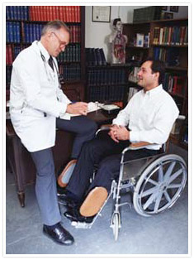
Respect, Safety, and Nondiscrimination: Respect Patients
Patient’s have the right to considerate, respectful and compassionate care.
Respect means valuing the patient's:
  Needs
  Desires
  Feelings
  Ideas
  Healthcare providers must respect the patient's:
  Cultural and personal values, beliefs, and preferences
  Right to privacy
  Right to effective communication
  Right to pain management

Slide 26

Respect, Safety, and Nondiscrimination: Respect Into Action
You should put your respect for patient rights into action by:
  Treating each patient in a respectful manner that supports his or her dignity
  Involving each patient in his or her care, treatment, and services
  Accommodating religious or other spiritual services
  Treat patients with common courtesy. For example:
  Knock and wait before entering a patient's room.
  Respond politely to patients.
  Listen to patients.
  Remain compassionate.

Slide 27
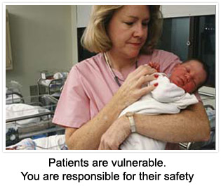
Respect, Safety, and Nondiscrimination: Safety
Patients have the right to safety and security. Do your part to ensure a safe environment of care for your patients.
Know your facility's policies for:
  Environmental safety
  Infection control
  Security
  Report to your supervisor immediately if:
  You think a patient may be victim of abuse
  A patient asks for protection from abuse
Patients are vulnerable.
You are responsible for their safety.

Slide 28
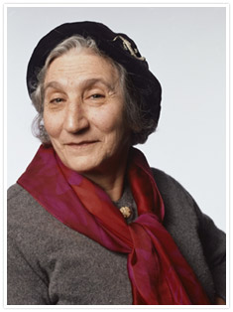
Respect, Safety, and Nondiscrimination: Nondiscrimination
All patients have the right to fair and equal healthcare.
This is true regardless of:
  Race
  Ethnicity
  National origin
  Religion
  Political affiliation
  Level of education
  Place of residence or business
  Age
  Gender
  Marital status
  Personal appearance
  Mental or physical disability
  Sexual orientation
  Genetic information
  Source of payment

Slide 29
Patient Visitation Rights
A patient has the right to decide on who his or her visitors are, even if they are not related to the patient.
Visitors may:
  Include spouses, domestic partners (same or opposite sex), family members, friends, or other support individuals the patient chooses
  Be restricted or limited for clinical or safety reasons, as described in the hospital’s written policies
  Not be denied visiting privileges on the basis of race, color, national origin, sex, religion, age, sexual orientation, gender identity, or disability
  Have full and equal visitation privileges as consented to by the patient
  Be allowed to remain with the patient for emotional support during the hospital stay
  Include other patients, provided that they do not have infections that could endanger the patients whom they are visiting
Your hospital should have written policies for visitors and for patients, and should inform the patient about the patient’s rights to visitors, including any limitation and reasons for them.

Slide 30
Grievances
Patients have the right to complain about the quality of their care.
Many patient complaints can be addressed quickly.
When complaints cannot be resolved quickly and easily, patients have the right to file a grievance.
A grievance is a formal complaint.
Common Causes of Complaints
Waiting Times
Operating Hours
Conduct of Staff
Adequacy of Staff

Slide 31
Grievances
If a patient wants to file a grievance:
Explain the grievance process at your organization. This includes the name of the staff person the patient should contact.
Explain that grievances may be filed with state agencies. This is true whether or not the patient has already used the facility's internal grievance process.
Give the patient the phone number and address for filing a grievance with the state.

Slide 32
Lesson 3: Quality Improvement
Welcome to the lesson on quality improvement.
This lesson covers:
  Why quality improvement is important
  What quality improvement is
  Our expectations
  The PDSA cycle

Slide 33
Why is Quality Improvement Important?
Quality Improvement is not only a smart business practice,
it is our mission to provide quality services.
Mission Statement
McLaren Health Care, through it’s subsidiaries,
will be the best value in healthcare
as defined by quality outcomes and cost.

Slide 34
What is Quality Improvement?
Continually improving organizational performance.
A process aimed at achieving desired results.
A step by step methodology for finding out what is needed to ensure good performance and then delivering it.
An approach to process design that includes measurement, analysis, and sustained improvement.
A system for continually improving what we do.
Team-centered work toward a common, understood goal.

Slide 35
Our Expectation
Our expectation is that we engage in ongoing improvement initiatives to achieve our mission.
The process we use at McLaren Health Care is the IHI Model.
  IHI stands for Institute for Healthcare Improvement
  www.ihi.org

Slide 36
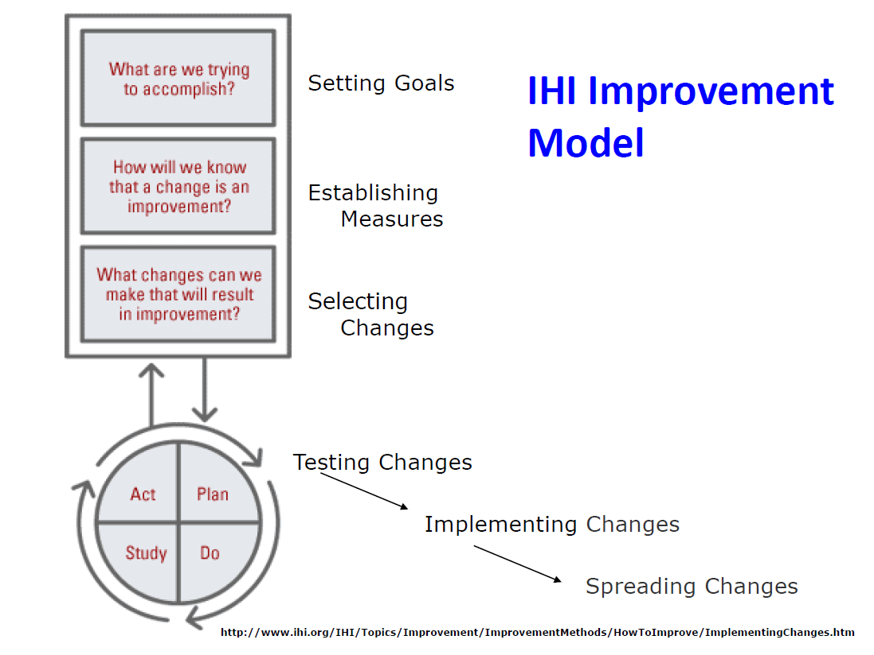

Slide 37
PDSA Cycle - The Foundation
PLAN
  Make the plan! How will the change be implemented?
DO
  Implement the plan, measuring progress as you go
STUDY/CHECK
  Critically evaluate the results by asking: “What went right?” “What went wrong?” “Why?”
ACT
  Adjust, Abandon, Adopt, Spread the Changes
This cycle is repeated
to build improvements upon successes!

Slide 38
Questions???
Contact your Subsidiary Compliance/HIPAA/Privacy/Security Officer!

